Slide 1

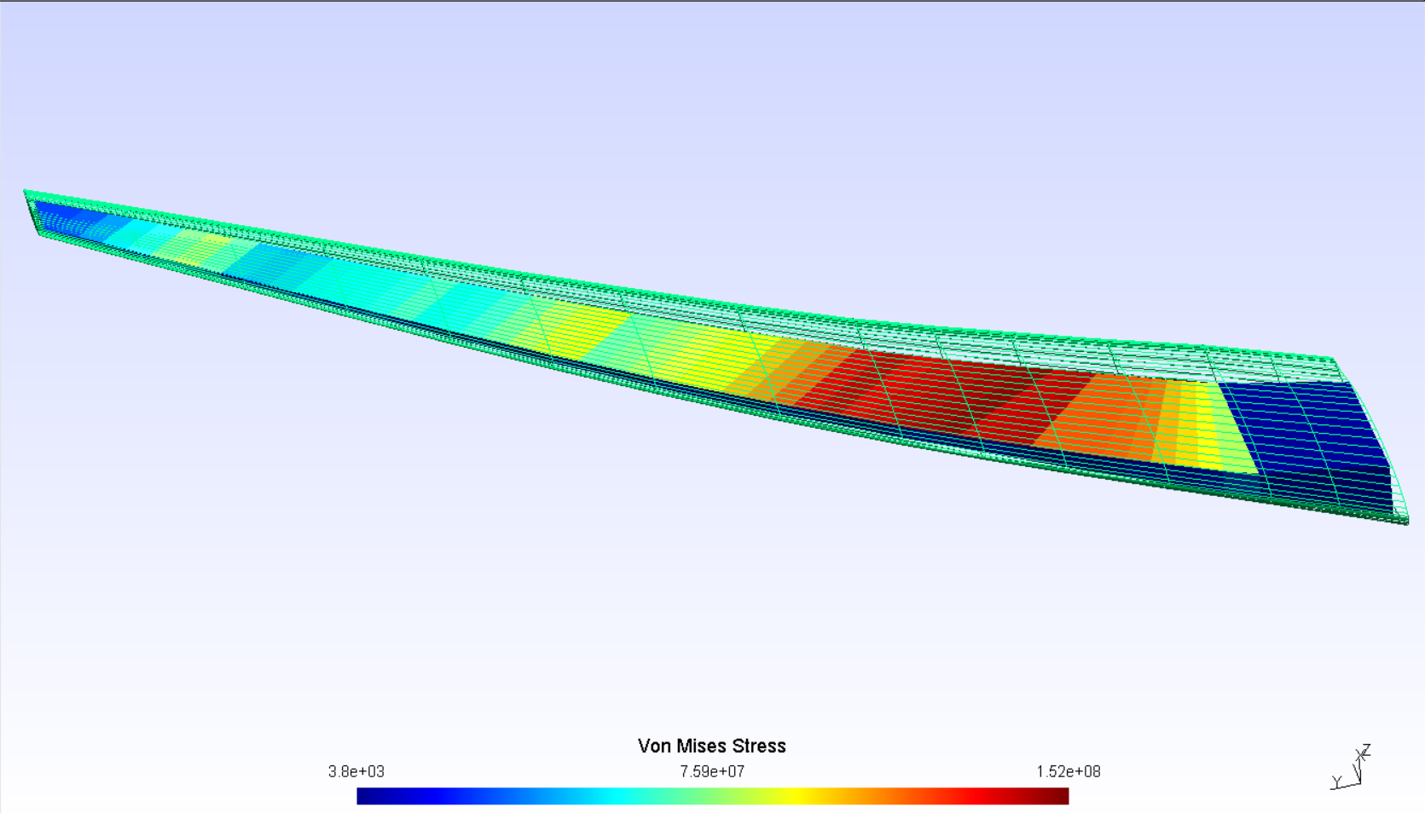

Multifidelity aeroelastic optimization with application to a BWB.
Gilberto RUIZ JIMÉNEZ¹;
Joan MAS COLOMER; Joseph MORLIER
1,2: ISAE-SUPAERO, Université de Toulouse, France 3: ICA, ONERA, France
1. gilberto.ruiz-jimenez@student.isae-supaero.fr
1. Introduction
3. Preliminary Results
4. Project Milestones
2. Proposed Method
Write the code that connects both fidelity levels in OpenMDAO.
Run the multi-fidelity optimization for the sample case.
Check performance of the new proposal vs. previous code and single fidelity.
Apply the method to a BWB configuration and validate the results.
Check for possible performance improvements for the complex case.
Root_Optimizer (CDi)
Rererence 1
Reference 2
xxx
MDA_Lo-Fi
Displacement
Field
Structural
Solver
Displacement
Transfer
Aerodynamic
Solver
Load
Transfer
MDA_Hi-Fi
Structural
Solver
Displacement
Transfer
Aerodynamic
Solver
Load
Transfer
Filter
Fig. X MDAO Diagram

